Slide 1



DISASTER RISK REDUCTION AND MANAGEMENT FUND
Office of Civil Defense - Rehabilitation and Recovery Management Service

Slide 2

SCOPE OF PRESENTATION
LDRRMF BACKGROUND
DILG-DBM JMC 2013-01
COA CIRCULAR 2012-002
PRESENTATION ON NATIONAL DRRM FUND

Slide 3
Background LDRRM Fund
Section 21. Local Disaster Risk" Reduction and Management Fund (LDRRMF). - The present Local Calamity Fund shall henceforth be known as the Local Disaster Risk Reduction and Management Fund (LDRRMF). Not less than five percent (5%) of the estimated revenue from regular sources shall be set aside as the LDRRMF to support disaster risk management activities such as, but not limited to, pre-disaster preparedness programs including training, purchasing life-saving rescue equipment, supplies and medicines, for post-disaster activities, and for the payment of premiums on calamity insurance. The LDRRMC shall monitor and evaluate the use and disbursement of the LDRRMF based on the. LDRRMP as incorporated in the local development plans and annual work and financial plan. Upon the recommendation of the LDRRMO and approval of the sanggunian concerned, the LDRRMC may transfer the said fund to support disaster risk reduction work of other LDRRMCs which are declared under state of calamity.
Of the amount appropriated for LDRRMF, thirty percent (30%) shall be allocated as Quick Response Fund (QRF) or stand-by fund for relief and recovery programs in order that situation and living conditions of people In communities or areas stricken by disasters, calamities, epidemics, or complex emergencies, may be normalized as quickly as possible.
Unexpended LDRRMF shall accrue to a special trust fund solely for the purpose of supporting disaster risk reduction and management activities of the LDRRMCs within the next five (5) years. Any such amount still not fully utilized after five (5) years shall revert back to the general fund and will be available for other social services to be identified by the local sanggunian.

Slide 4
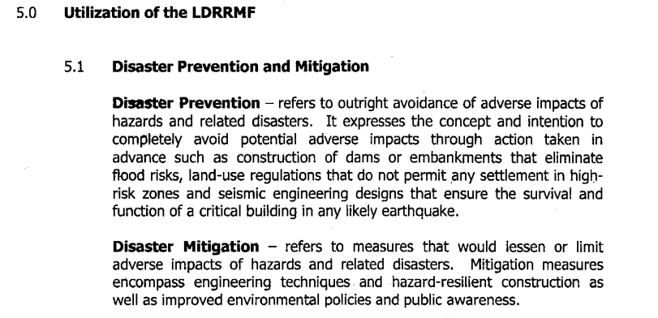
DILG-DBM JMC 2013 - 01

Slide 5
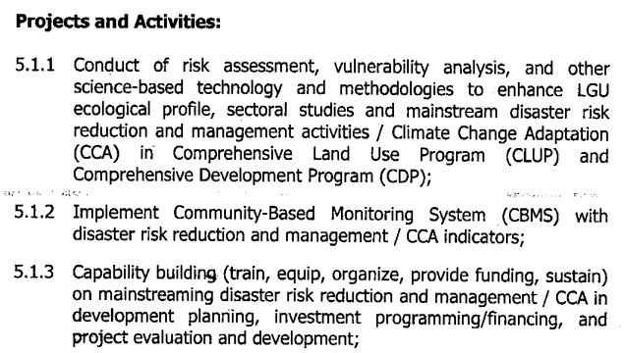
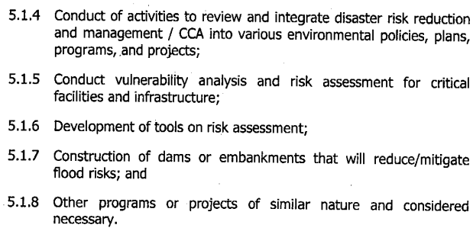
DILG-DBM JMC 2013 - 01

Slide 6
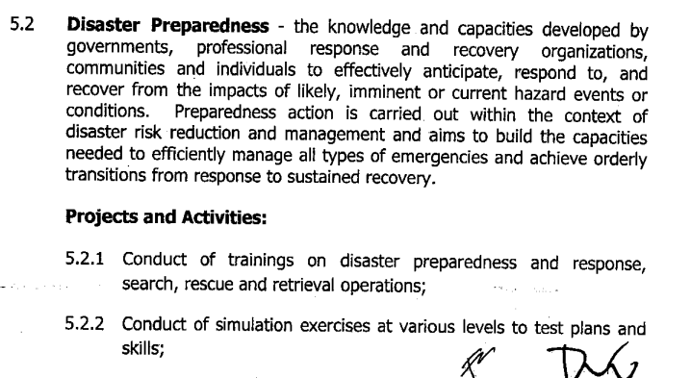
DILG-DBM JMC 2013 - 01

Slide 7
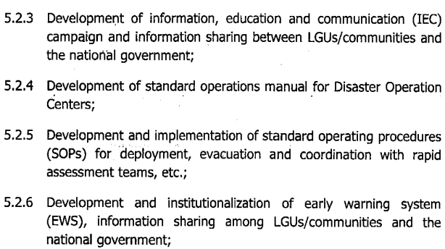
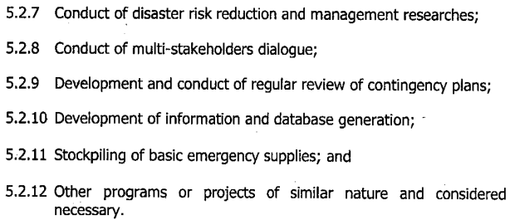
DILG-DBM JMC 2013 - 01

Slide 8
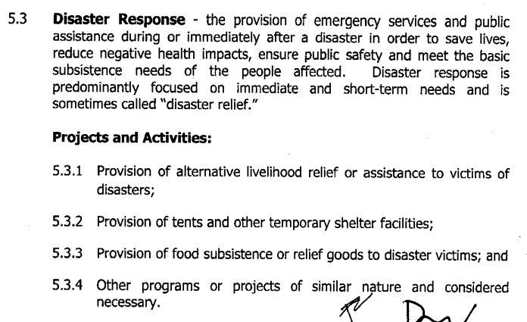
DILG-DBM JMC 2013 - 01

Slide 9
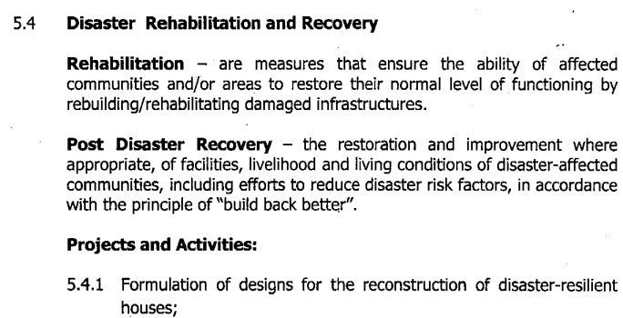
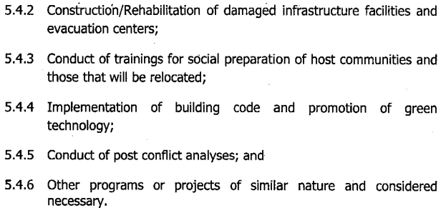
DILG-DBM JMC 2013 - 01

Slide 10
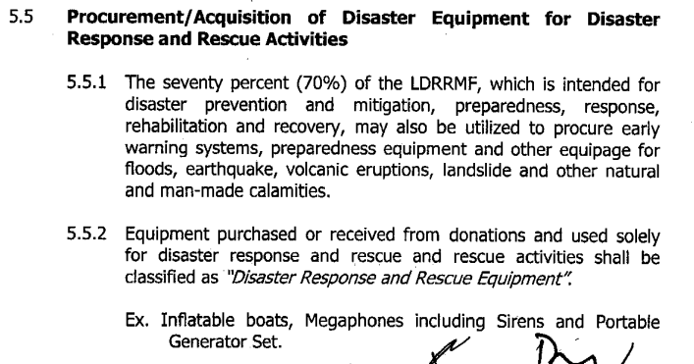
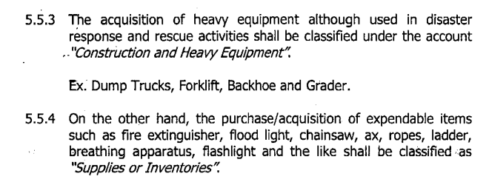
DILG-DBM JMC 2013 - 01

Slide 11
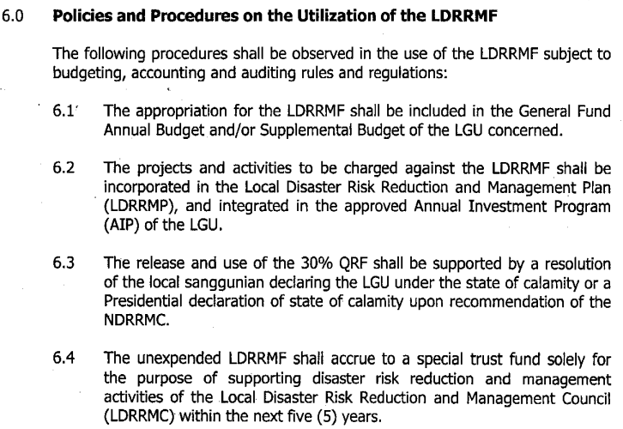
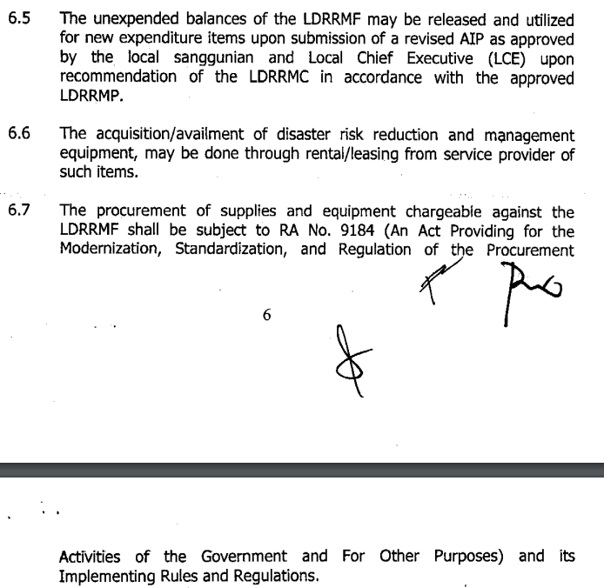
DILG-DBM JMC 2013 - 01

Slide 12
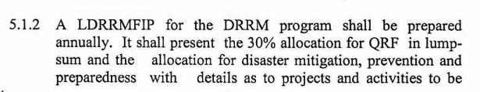
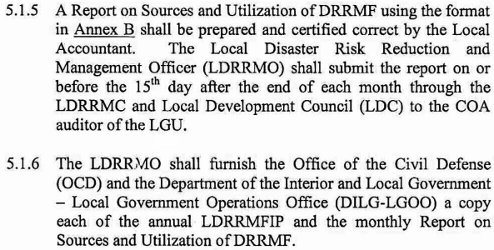
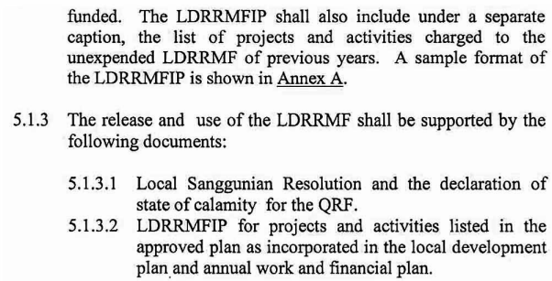
COA CIRCULAR 2012-002

Slide 13
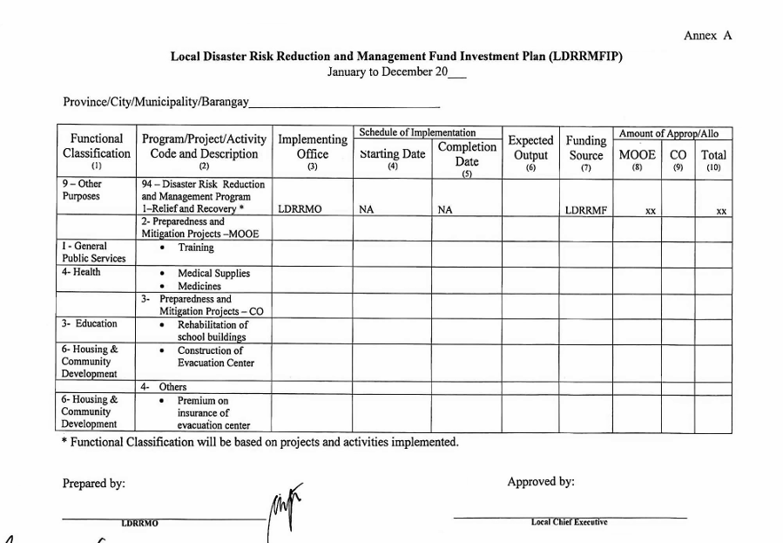
COA CIRCULAR 2012-002

Slide 14
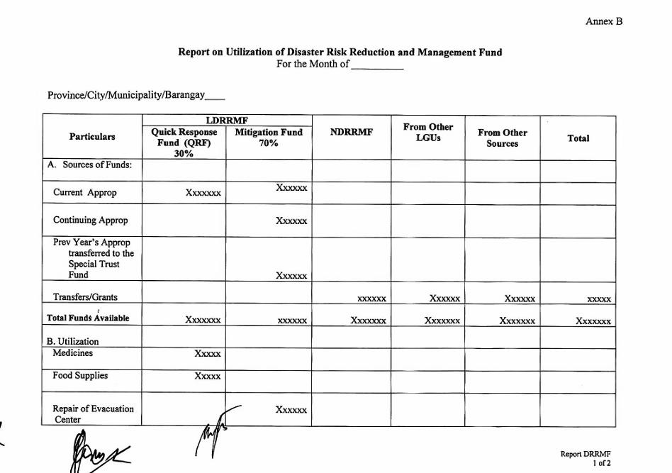
COA CIRCULAR 2012-002

Slide 15
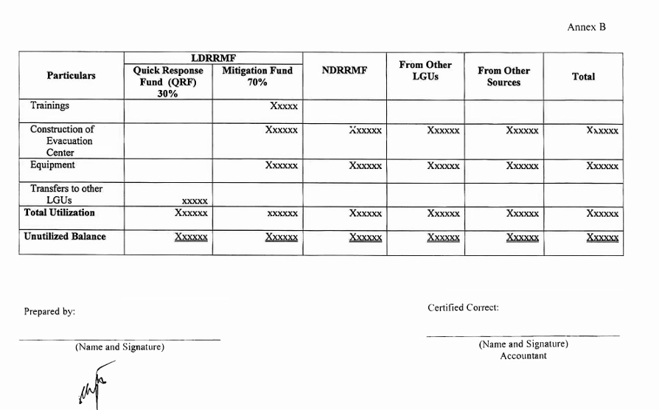
COA CIRCULAR 2012-002

Slide 16
Background NDRRM Fund
Section 22 of RA 10121. National Disaster Risk" Reduction and Management Fund. shall be used for:
disaster risk reduction or mitigation, prevention and preparedness activities
relief, recovery, reconstruction and other work or services for calamities which may occur during the budget year or past two (2) years from the budget year.
released upon approval of the President of the Philippines in accordance with the favorable recommendation of the NDRRMC
thirty percent (30%) shall be allocated as Quick Response Fund (QRF) for relief and recovery programs for disaster-affected areas to be normalized as quickly as possible.

Slide 17

DISASTER PREPAREDNESS, PREVENTION AND MITIGATION

Slide 18
Process Flow Pre-Disaster Interventions
Increased Capacity
6
5
Transmittal of Request to OP for approval
Sub-Total OCD&DND:
7-12 Working days
4
Approves and signs recommendation letter to OP
OCD CO
3
Endorsement to SND of Letter to OP
1-2 Working Days
SND/C, NDRRMC
2
3-5 Working Days
1 Week
OCD CO
RDRRMC
3-5 Working Days
OCD RO reviews, recommend, endorse to NDRRMC thru OCD CO
1
Not Later than End of June Every Year
LGU
1-2 Weeks
Submission of proposal w/ complete documentary requirements
RDRRMC
Identification and Call for Proposal for Priority LGUs

Slide 19
Menu of Projects (Pre-Disaster)
Establishment Local Emergency Operations Centers and its equipage;
Construction of local evacuation centers and other local infrastructure projects for disaster prevention and mitigation based on national standard design;
Construction of other local and national DRRM facilities in accordance with the NDRRM Plan;
Construction/Establishment of training centers and facilities for DRRM;
Establishment of early warning systems;
Procurement of emergency telecommunications equipment and systems for geographically isolated LGUs;
Procurement of mission essential vehicles and equipment;
Conduct of risk assessments and other research for DRRM;
Trainings and capacity building for LGU DRRM personnel;
Support to GK LGU Awardees;
Other priority programs and projects recommended by the NDRRMC Preparedness, Prevention and Mitigation Pillar, or the ED, NDRRMC/A, OCD subject to approval of the Chairperson, NDRRMC

Slide 20
Documentary Requirements
Endorsement Letter from Head of Agency or Local Chief Executive; Work and Financial Plan for non-infra or Project Design documents Program of Works, Detailed Engineering Design for infra-related requests (DBM BED Form); Certificate of Unavailability of Funds with LDRRM Fund and Special Trust Fund Report (for LGUs); Certification of Capability to Implement Infrastructure Project (For LGUs) Certificate of Inclusion of Proposed Project in LDRRMP from concerned OCDRO (for LGUs); Counter-part funds for 1st to 3rd Income Class Municipalities.

Slide 21
Emergency Response and Early Recovery

Slide 22
Process Flow for Phase III – Early Recovery Interventions of NGAs
Return to Normalcy
6
NGAs initially provide funds for program implementation.
5
Transmittal of Request to OP for approval
Sub-Total OCD&DND:
7-12 Working days
4
Approves and signs recommendation letter to OP
OCD CO
3
Endorsement to SND of Letter to OP
1-2 Working Days
SND/C, NDRRMC
2
3-5 Working Days
1-2 Weeks
OCD CO
Implementing Agency
3-5 Working Days
Request Preparation and Submission for Budget Augmentation from NDRRMF
1
1-2 Weeks
Early Recovery Cluster
1-2 Weeks
Presentation of RDANA Result, Agreement on Priority Needs for Funding Using QRF and Agency Budgets
RDANA Team
Assessment of Initial Damages and Needs for Early Recovery

Slide 23
Menu of Projects (Disaster Response)
Procurement of food and non-food items;
Logistical expenses for pre-positioning of resources;
Deployment of assets such as but not limited to search and rescue teams and equipment, emergency telecommunications, water and sanitary supplies, generator sets;
Support to camp-management of displaced populations;
Other priority programs and projects recommended by the NDRRMC Response Pillar and approval of the Chairperson, NDRRMC

Slide 24
Menu of Projects (Early Recovery)
Social Protection Programs such as emergency cash transfer, shelter assistance, cash-for-work, rental subsidy programs;
Livelihood Support such as credit assistance, support for MSMEs, skills training;
Agricultural Support such as provision of seeds, fertilizers, equipment, and other interventions;
Repair and Restoration of power and water supply;
Debris Clearing and minor repair of damaged roads and bridges and its auxiliary parts; or setting up of temporary bridges to restore transport; and
Repair of damaged schools and hospitals with minor damages, replacement of damaged equipment.

Slide 25
REHABILITATION AND RECONSTRUCTION

Slide 26
Process Flow for Phase IV – Regional Project Validation and Evaluation Team Assessment
4
Disaster with minor damages
1 to 3 months
5
Sub-Total Pre-Requisite(N/R DRRMC):
2 – 4 weeks and 3 days
3
Requesting Party (NGAs, **LGUs) Submission of proposal w/ complete documentary requirements
2
3 working days
OCD RO reviews, recommend, endorse to NDRRMC thru OCD CO
RDRRMC
Endorses priority list
1
1-2 weeks
6
Total OCD & DND:
2 to 4 weeks
RPVET Actual Inspection.
Determination of LGU Capacity
3-5 Working Days
1-2 weeks
Review Damage and RDANA Report, Call for Proposal
Review of Proposal and Endorsement to SND
7
8
OCD CO
Approves and signs recommendation letter to OP
3-5 Working Days
Transmittal of Request to OP for approval
Sub-Total OCD&DND:
12-17 Working days
SND/C, NDRRMC
3-5 Working Days
OCD CO
1-2 Working Days

Slide 27
Process Flow for Phase IV – With PDNA and RRP (If Necessary)
Disaster with disruptive damages
6
5
Transmittal of Request to OP for approval
4
Approves and signs recommendation letter to OP
Sub-Total OCD&DND:
7-12 working days
Sub-Total Pre-Requisite(N/R DRRMC):
3 months
OCD CO
3
Review of Proposal and Endorsement to SND
SND/C, NDRRMC
1-2 Working Days
1-3 months
3-5 Working Days
2
OCD CO
Requesting Party (NGA/LGU)
Submission of proposals with complete documentary requirements for the identified priorities
3-5 Working Days
Timeline:
3 ½ mos. plus additional 1-3 mos. for
proposal preparation
1
1 month
Crafting of Rehab & Recovery Plan
2 months
▪Identification of Priorities for NDRRMF Funding
▪Determination of LGU Capacity
Conduct of PDNA

Slide 28
Menu of Projects (Rehabilitation and Reconstruction)
Major repair or reconstruction of roads and bridges and its auxiliary parts (e.g. collapsed road and bridges, slope protection, road slip, etc.).
Major repair/reconstruction of damaged schools, hospitals, and other public buildings such as evacuation centers, municipal halls, etc.
Repair/rehabilitation/reconstruction of damaged irrigation facilities.
Repair/rehabilitation/reconstruction of damaged disaster mitigating structures such as flood control, dikes, river control, sea wall, etc.
Resettlement Program for displaced population.
In the case of El Niño, priority programs and projects identified in RRP or by the concerned RDRRMC.

Slide 29
Documentary Requirements
Non-Infrastructure Projects
Endorsement Letter from LCE or Agency Head with Project Proposal Template Work and Financial Plan with List of Target Beneficiaries (for Resettlement Projects) Social Awareness and Consultations for Beneficiary Community/Family (for Resettlement Projects) Certificate of Land Availability. Transfer Certificate of Title or Deed of Sale or Donation for Resettlement Projects)
Infrastructure Projects
Endorsement Letter from LCE or Agency Head with Project Proposal Template Project Design documents Program of Works, Detailed Engineering Design, etc. Calamity Damaged Report with Geotagged and Time-Stamped Photo Certificate of Unavailability of Funding (For LGUs accompanied by LDRRM and Special Trust Fund and Received NDRRM Fund Utilization Report – COA Stamped Certification from DPWH of compliance to standard design and costing (If LGU wants to implement the project) Certification of Capability to Implement Infrastructure Project (If LGU wants to implement the project) Hazard Assessment of Project Location (for Reconstruction/Construction of Damaged Facility to a New Location)

Slide 30
Thank You!

